Slide 1
Data Science Capstone project
<NGIAM TEE JOHN>
<August 2021>

Slide 2

Outline
Executive Summary
Introduction
Methodology
Results
Conclusion
Appendix

Slide 3

Executive Summary
This capstone project uses data from previous SpaceX launches and predicts future success launches from the data with machine learning models and visual aid.
Visual aid such as graphs charts and maps are used for better illustration and communication to stakeholders.

Slide 4

Introduction
Calculating the cost of a falcon 9 launch against its historical launches and its success rate using machine learning and charts to better predict future launches outcome
How to determine whether future launches will result in a successful outcome

Slide 5

Methodology
Data collection methodology:
Data were collected from SpaceX and Wikipedia
Perform data wrangling
Replacing missing data, one – hot encoding data and changing column variables
Perform exploratory data analysis (EDA) using visualization and SQL
Perform interactive visual analytics using Folium and Plotly Dash
Perform predictive analysis using classification models

Slide 6
Methodology

Slide 7
Data collection – SpaceX API
Request data from SpaceX API
Select data needed and create a dictionary
Convert dictionary to dataframe and export as CSV
Added a flowchart of SpaceX API calls here
https://github.com/johnpro18/Coursera-Capstone-Project/blob/main/SpaceX%20_%20Data%20Collection.ipynb

Slide 8
Data collection – Web scraping
Extract data from websites
Select data needed and create a dictionary
Convert dictionary to dataframe and export as CSV
Add a flowchart of web scraping here
https://github.com/johnpro18/Coursera-Capstone-Project/blob/main/SpaceX%20_%20Web%20Scrapping.ipynb

Slide 9
Data wrangling
Replace NULL values
One – hot encode some variables for better processing
Convert to dataframe and export as CSV
https://github.com/johnpro18/Coursera-Capstone-Project/blob/main/SpaceX%20_%20Data%20Wrangling.ipynb

Slide 10
EDA with data visualization
Scatterplot is used to better visualize the correlation between two variables
Line chart is used to better visualize success rate with time
Bar chart is used to better visualize variables affecting success rate
https://github.com/johnpro18/Coursera-Capstone-Project/blob/main/SpaceX%20_%20Data%20Visualization.ipynb

Slide 11
EDA with SQL
SQL is used to better understand queries with specific conditions and to better understand the data used before using it on machine learning
https://github.com/johnpro18/Coursera-Capstone-Project/blob/main/SpaceX%20_%20SQL.ipynb

Slide 12
Build an interactive map with Folium
Circle marker is used to denote the launch site
Cluster marker is used to denote successful and unsuccessful launches on each launch site
Marker was added to visualize the distance between railroads, highways, and coastlines
https://github.com/johnpro18/Coursera-Capstone-Project/blob/main/SpaceX%20_%20Web%20Scrapping.ipynb

Slide 13
Build a Dashboard with Plotly Dash
Pie chart displays the successful outcomes and the unsuccessful outcomes for each and all launch sites
Scatter plot displays the correlation between payload mass and success rate for each and all launch sites
https://github.com/johnpro18/Coursera-Capstone-Project/blob/main/spacex_dash_app.py

Slide 14
Predictive analysis (Classification)
Convert and standardize X and Y
Split X and Y into training and testing
Calculate each model’s accuracy and use the best model
https://github.com/johnpro18/Coursera-Capstone-Project/blob/main/SpaceX%20_%20Machine%20Learning.ipynb

Slide 15
Results
Exploratory data analysis results
Interactive analytics demo in screenshots
Predictive analysis results

Slide 16
EDA with Visualization

Slide 17
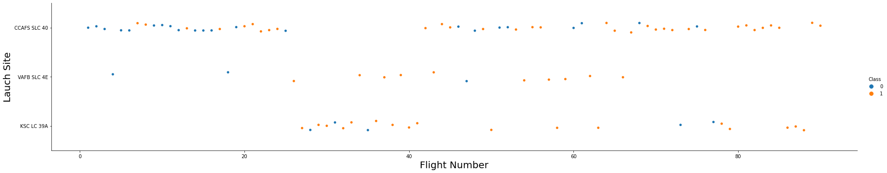
Flight Number vs. Launch Site
The most used launch site is CCAFS SLC-40 and the most recent launch is from the same launch site
Show a scatter plot of Flight Number vs. Launch Site
Show the screenshot of the scatter plot with explanations

Slide 18
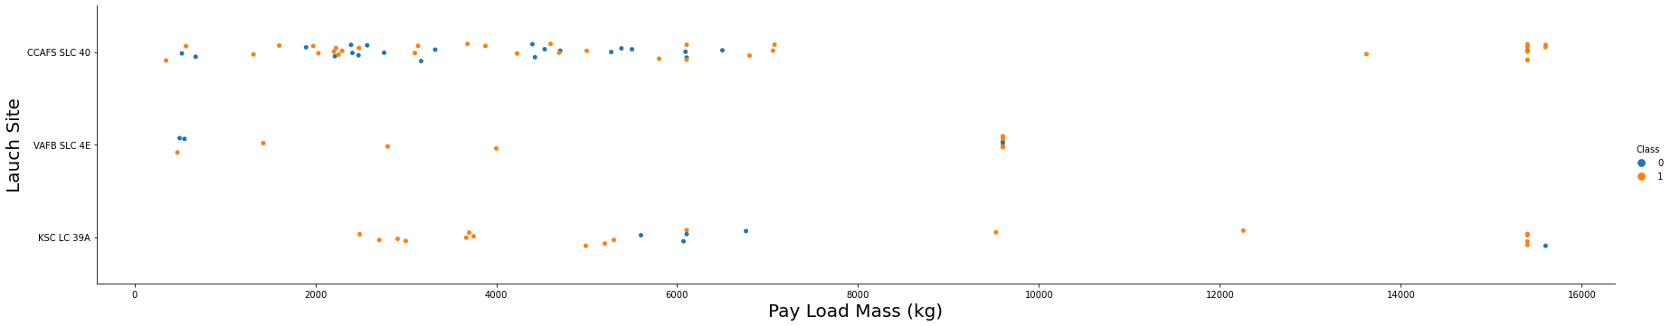
Payload vs. Launch Site
Launch site CCAFS SLC-40 is most used for normal payload and launch site CCAFS SLC-40 and KSC LC-39A are used for higher payload
Show a scatter plot of Payload vs. Launch Site
Show the screenshot of the scatter plot with explanations

Slide 19
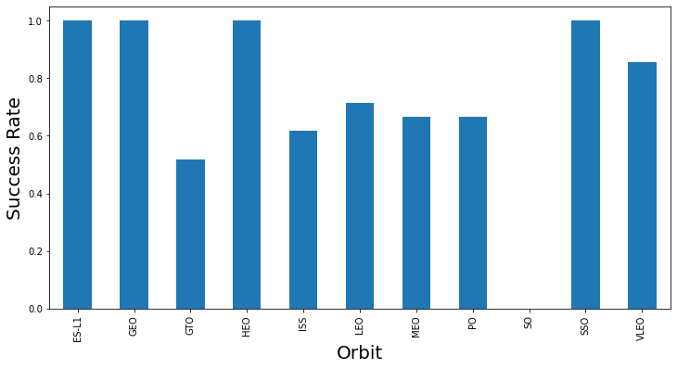
Success rate vs. Orbit type
ES-L1, GEO, HEO, and SSO have the highest success rate
Show a barchart for the success rate of each orbit type
Show the screenshot of the scatter plot with explanations

Slide 20
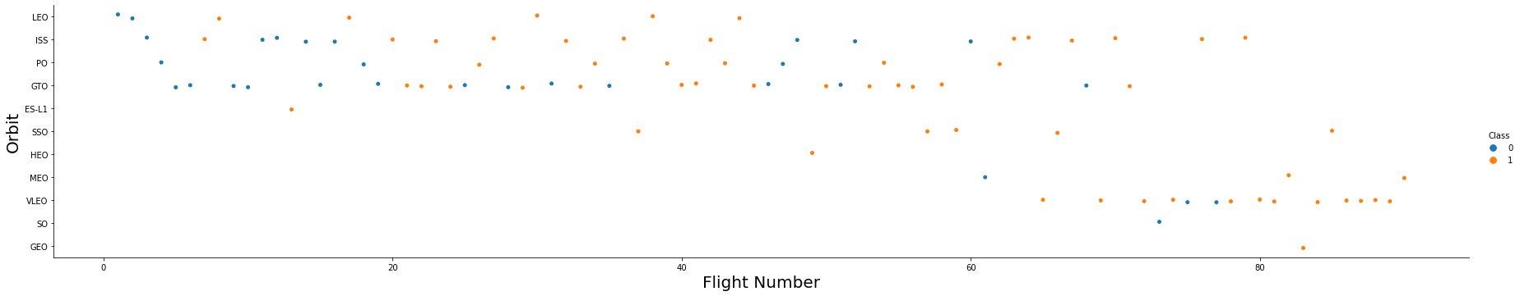
Flight Number vs. Orbit type
Earliest launches are above the GTO whereas recent launches are around VLEO
Show a scatter point of Flight number vs. Orbit type
Show the screenshot of the scatter plot with explanations

Slide 21
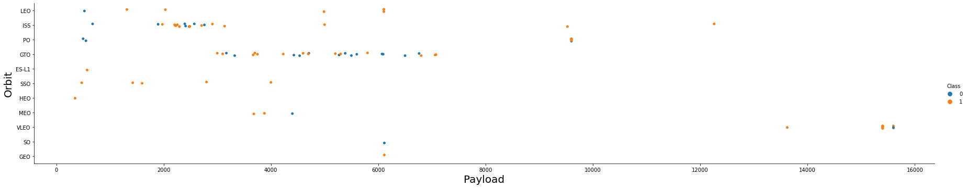
Payload vs. Orbit type
Lighter payload are launched towards GTO and ISS whereas heavier payload are launched towards VLEO
Show a scatter point of payload vs. orbit type
Show the screenshot of the scatter plot with explanations

Slide 22
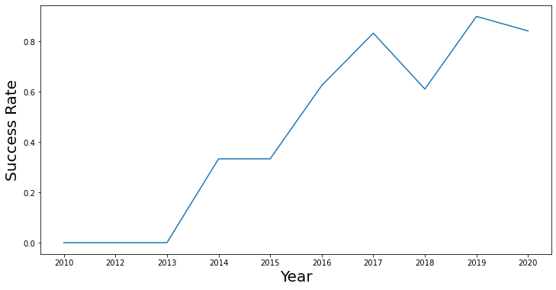
Launch success yearly trend
Success rate increases from 2013 to 2017 and dipped slightly and continue to increase towards 2020
Show a line chart of yearly average success rate
Show the screenshot of the scatter plot with explanations

Slide 23
EDA with SQL

Slide 24
All launch site names
Find the names of the unique launch sites
CCAFS LC-40, CCAFS SLC-40, KSC LC-39A, VAFB SLC 4E
Present your query result with a short explanation here
Using SELECT Statement and Distinct Statement, the launch site names were displayed

Slide 25
Launch site names begin with `CCA`
Find all launch sites begin with `CCA`
CCAFS LC-40
Present your query result with a short explanation here
Using SELECT Statement with WHERE Condition ‘%CCA%’ results were displayed

Slide 26
Total payload mass
Calculate the total payload carried by boosters from NASA
45596
Present your query result with a short explanation here
Using SELECT and SUM STATEMENT the total payload mass was displayed

Slide 27
Average payload mass by F9 v1.1
Calculate the average payload mass carried by booster version F9 v1.1
2928
Present your query result with a short explanation here
Using SELECT and AVG STATEMENT the average payload mass by F9 v1.1 is displayed

Slide 28
First successful ground landing date
Find the date when the first successful landing outcome in ground pad
2010-06-04
Present your query result with a short explanation here
Using SELECT and MIN STATEMENT the first successful ground landing date was displayed

Slide 29
Successful drone ship landing with payload between 4000 and 6000
List the names of boosters which have success in drone ship and have payload mass greater than 4000 but less than 6000
F9 FT B1022, F9 FT B1026, F9 FT B1021.2, F9 FT B1031.2
Present your query result with a short explanation here
Using SELECT and BETWEEN STATEMENT the booster versions with successful drone ship landing were displayed

Slide 30
Total number of successful and failure mission outcomes
Calculate the total number of successful and failure mission outcomes
100 Successful Missions and 1 Failure Mission
Present your query result with a short explanation here
Using SELECT and COUNT STATEMENT to display total number of successful and failure missions

Slide 31
Boosters carried maximum payload
List the names of the booster which have carried the maximum payload mass
Present your query result with a short explanation here

Slide 32

2015 launch records
List the records which will display the month names, failure landing_outcomes in drone ship ,booster versions, launch_site for the months in year 2015
Present your query result with a short explanation here
Using SELEECT and WHERE STATEMENT to display landing outcome with failure (drone ship)

Slide 33
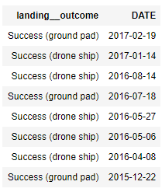
Rank success count between 2010-06-04 and 2017-03-20
Rank the count of successful landing_outcomes
between the date 2010-06-04 and 2017-03-20
in descending order.
Present your query result with a short explanation here
Using SELECT and ORDER BY DESC STATEMENT to display successful landing outcome in descending order between 2010-06-04 and 2017-03-20

Slide 34
Interactive map with Folium

Slide 35
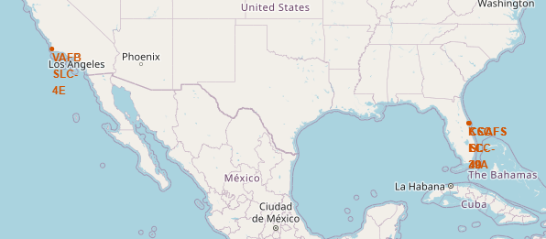
Launch Sites Location
Explain the important elements and findings on the screenshot
Launch sites are positioned near the equator and the coast line

Slide 36
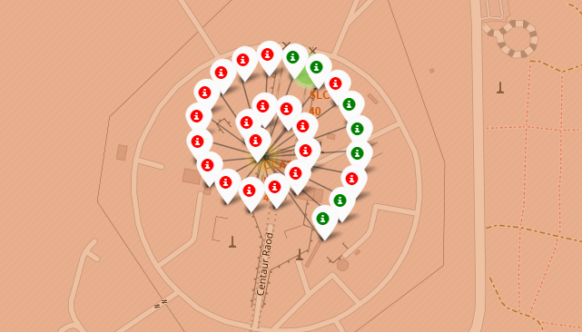
LAUNCH SITE OUTCOMES
Explain the important elements and findings on the screenshot
The folium map shows all the successful and unsuccessful launches at each launch site

Slide 37
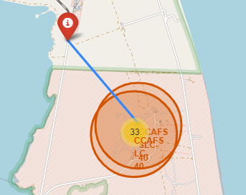
CLOSEST RAILWAY TO LAUNCH SITE
Explain the important elements and findings on the screenshot
The folium map shows the closest railway for transportation of rocket parts and personnel

Slide 38
Build a Dashboard with Plotly Dash

Slide 39
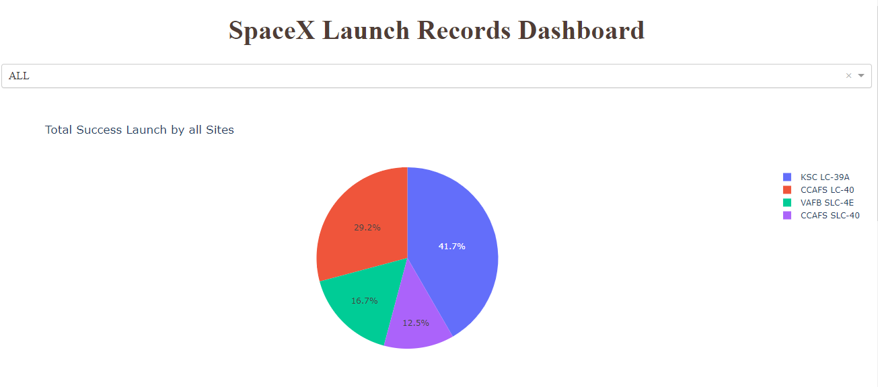
Dashboard landing site

Slide 40
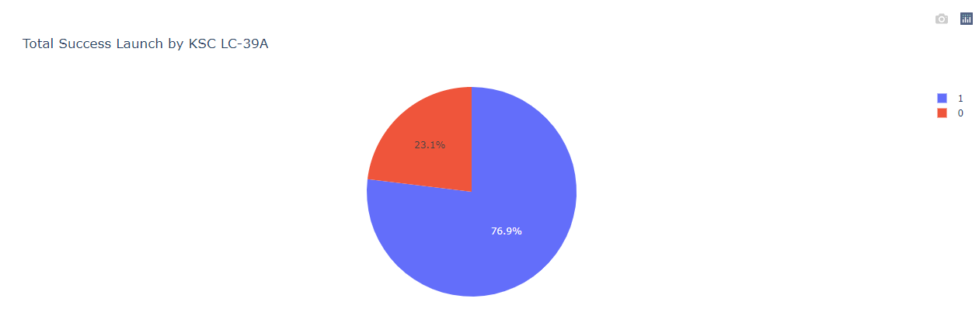
Highest success rate for a launch site

Slide 41
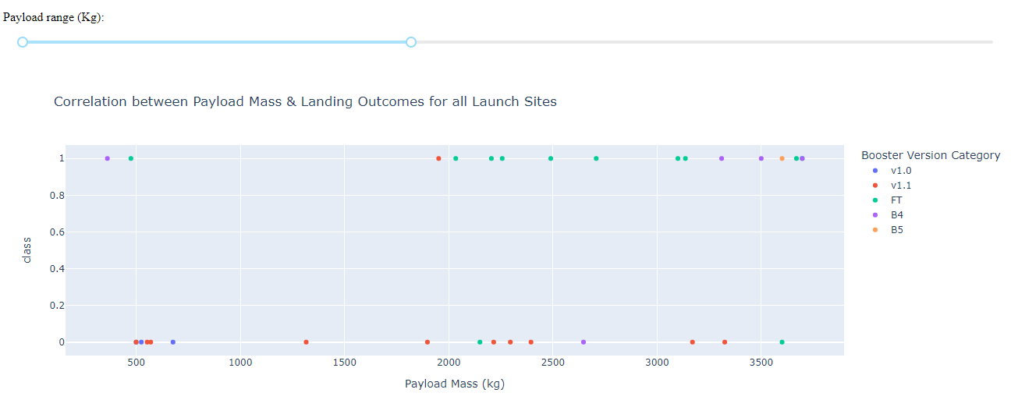
Correlation payload & outcome for all sites

Slide 42
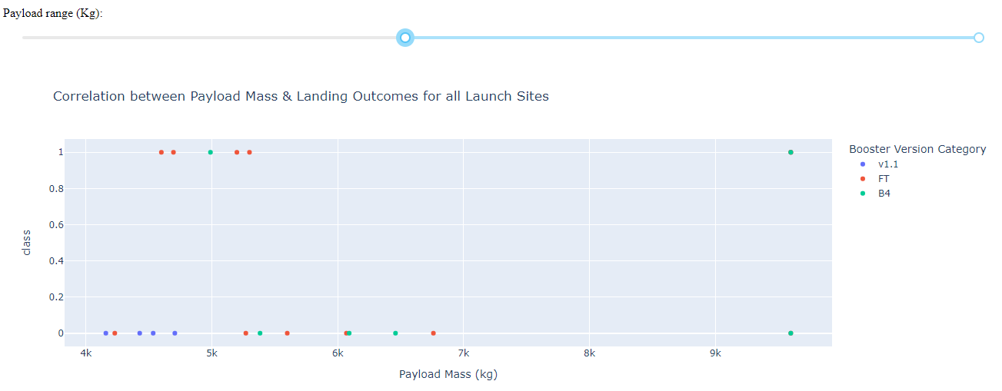
B4 boosters are used more often for higher payload mass

Slide 43
Predictive analysis (Classification)

Slide 44
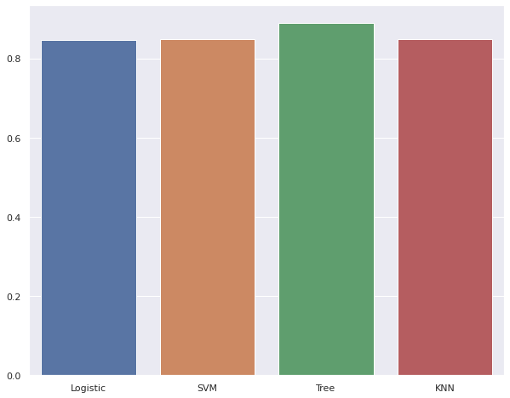
TRAIN Classification Accuracy
Visualize all the built model accuracy for all built models, in a barchart
Find which model has the highest classification accuracy

Slide 45
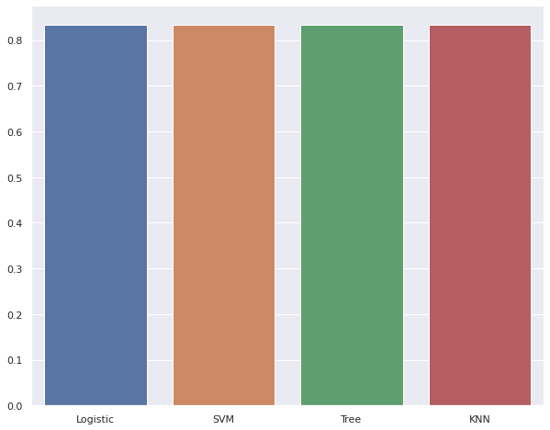
TEST Classification Accuracy
SINCE TEST CLASSIFICATION HAS EQUAL ACCURACY TREE TRAIN CLASSIFICATION HAS HIGHER ACCURACY WHICH WILL BE USED

Slide 46
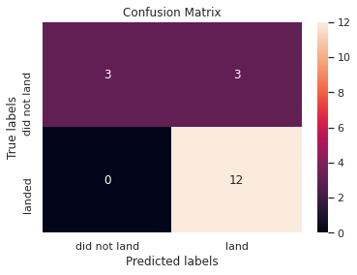
Confusion Matrix
There were 3 correct predictions of did not land outcomes, 3 incorrect predictions of landed outcomes and 12 correct predictions of landed outcomes

Slide 47

CONCLUSION
All launch sites have equally close success rate however the increase of success rate may be due to the increase of payload mass.
Tree model is used as the best model as it has a accuracy of 83.33% which will be more accurate as more data is collected and tested.

Slide 48

APPENDIX
Include any relevant assets like Python code snippets, SQL queries, charts, Notebook outputs, or data sets that you may have created during this project

